Slide 2
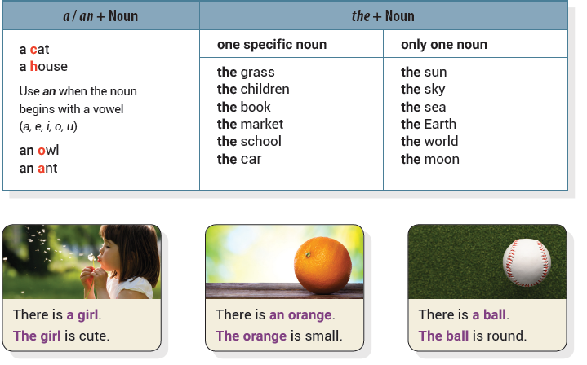
Unit 1 This Is the Park
UNIT OBJECTIVE: You will be able to use articles and nouns.

Slide 3
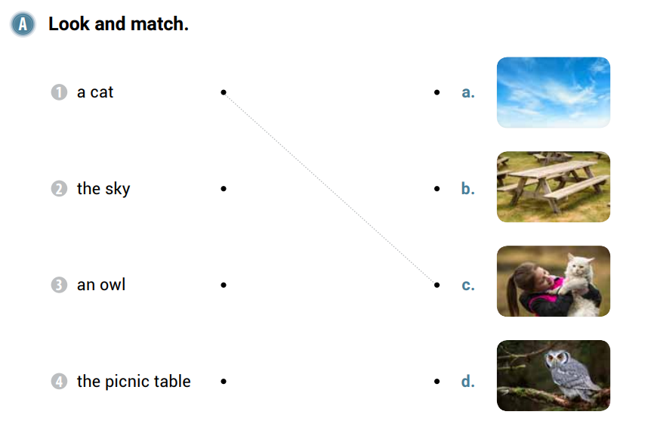

Slide 5
an
The
a
a
The
clock
The
car

Slide 7
a
toy
the
bird
an
egg

Slide 8
the
A
The

Slide 9
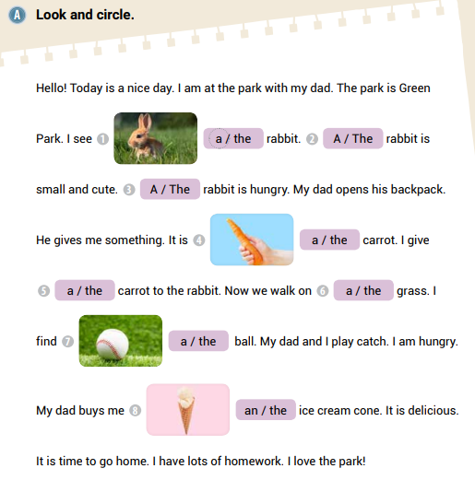

Slide 10
the
an
The
apple
a
The
strawberry
The

Slide 11
Unit 2 An Apple and Some Bread
UNIT OBJECTIVE: You will be able to use countable nouns and uncountable nouns.

Slide 13
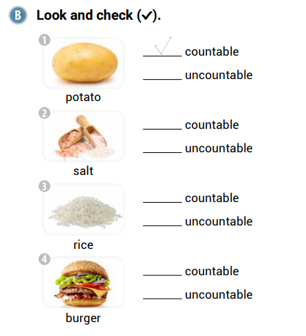

Slide 16
some
cheese
pasta
some
bread

Slide 18
some
coffee
a
cookie

Slide 19
some
lemons
an
orange
some
milk

Slide 20
an
a
a
a
a
a
some

Slide 21
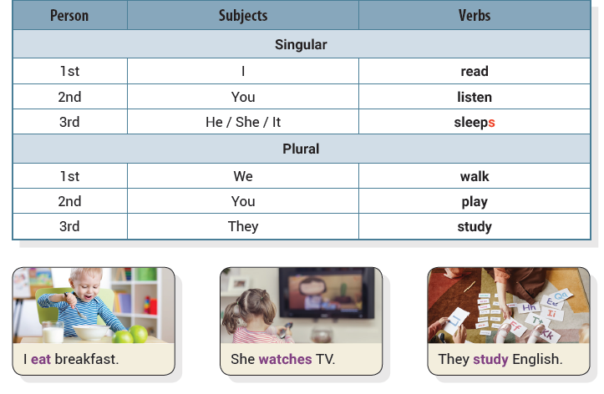
Unit 3 I Read a Book
UNIT OBJECTIVE: You will be able to use the present simple tense.

Slide 23
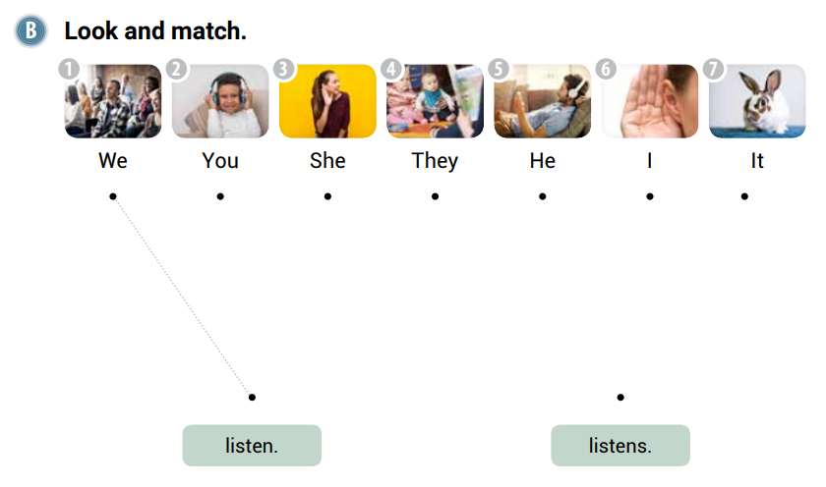

Slide 26
visit
buy
drinks

Slide 27
send
finish
closes

Slide 28
We carry our backpacks
You write a story

Slide 29
He catches the ball
They color the picture
Peter asks a question

Slide 30
meets
Kate
wears
walk
They
study
They
read
draw

Slide 31
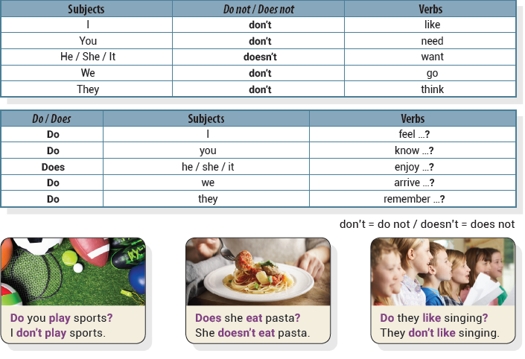
Unit 4 I Don’t Like Tennis
UNIT OBJECTIVE: You will be able to use the present simple tense in negatives and questions.

Slide 35
Does
he
Do
they
Do
they

Slide 37
We don’t wash our clothes.
My mother doesn’t clean the house.
They don’t finish their homework.

Slide 38
She doesn’t live in Brazil.
We don’t read the newspaper.

Slide 39
It doesn’t rain here.
He doesn’t play the piano.
You don’t watch TV.

Slide 40
don’t
doesn’t
Does
doesn’t
don’t

Slide 41
Unit 5 There Is a TV
UNIT OBJECTIVE: You will be able to use there with the verb be.

Slide 46
There
is
There
are
There
isn’t

Slide 47
Is there a newspaper
Is there a box
Are there any plates

Slide 48
There
are
There
isn’t
There
aren’t
There
is
There
isn’t

Slide 49
There
are
There
is
There
isn’t
There
aren’t

Slide 50
Unit 6 I Can Swim!
UNIT OBJECTIVE: You will be able to use can and can’t.

Slide 53
can’t
can’t
can

Slide 54
can’t
can
can’t

Slide 56
We can speak Italian
They can take the bus
You can’t play the piano

Slide 57
He can drive a car.
We can build a snowman.

Slide 58
You can’t swim.
I can play the piano.
They can’t fly.

Slide 59
can
can’t
can’t
can
can’t
can
can

Slide 60
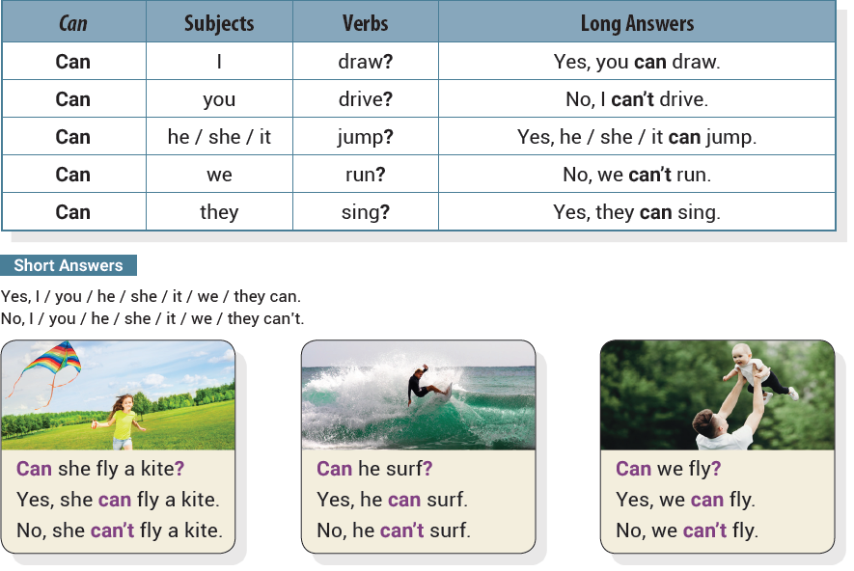
Unit 7 Can You Play Sports?
UNIT OBJECTIVE: You will be able to ask can questions.

Slide 65
Can she draw
Can he make a fire
Can they play basketball

Slide 66
No, they can’t go home.
Yes, it can jump.
No, we can’t play sports.

Slide 67
Can they speak French
Can she swim

Slide 68
Can we skateboard
Can it run
Can you ride a motorcycle

Slide 69
Can Owen walk
No, he can’t walk.
Can Owen stand
Can Owen catch a ball
Yes, he can stand.
Yes, he can catch a ball.

Slide 70
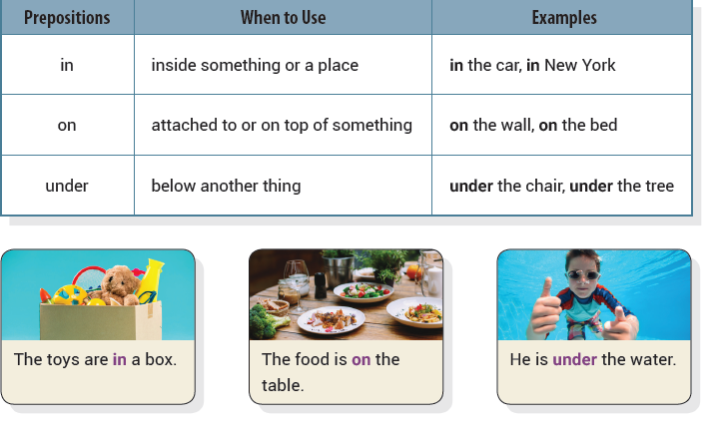
Unit 8 I Am in the Room
UNIT OBJECTIVE: You will be able to use in, on, and under with places.

Slide 75
under
in
on

Slide 76
in
in
under

Slide 77
She is in the car.
They are under the desk.

Slide 78
He is in the box.
It is under the rug.
It is on the desk.

Slide 79
under
on
on
in
on
on
under

Slide 80
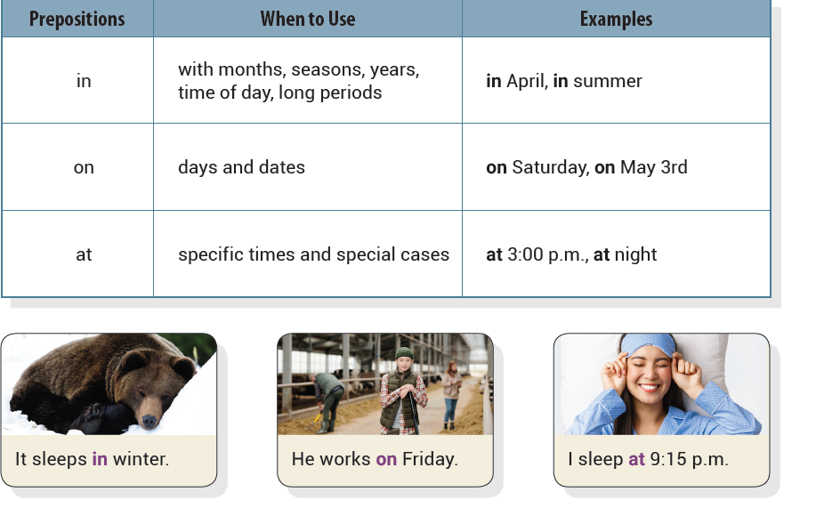
Unit 9 My Birthday Is in June
UNIT OBJECTIVE: You will be able to use in, on, and at with time.

Slide 82
on
at
on

Slide 85
at
on
in

Slide 86
at
in
on

Slide 87
She eats dinner at seven o’clock
He drinks coffee in the morning

Slide 88
I eat turkey on Thanksgiving
It snows in December
We come home at three o’clock

Slide 89
on
in
at
on
at
at

Slide 90
Unit 10 When Is the Test?
UNIT OBJECTIVE: You will be able to ask information questions with where and when.

Slide 95
When
Where
When

Slide 96
When is summer vacation
Where is the movie theater
When is the party

Slide 97
When is the hockey game
When is bedtime

Slide 98
Where is the book
When is the piano lesson
Where is your mother

Slide 99
When
When
Where
Where
is
Where

